Slide 1
Faculty of Mathematics and Physics
Charles University
Introduction to Game User Experience
Lecture 2

Slide 2
Practical info
Case studies - 1 larger study, 3 student studies
Game Development 2
GRUX 2021
Notes:
Similar to basic features of the game we talked about last time – to master the form, you

Slide 3
Shared Document
Let‘s go to the g-doc https://docs.google.com/spreadsheets/d/1S224KOCIWKzA_WloW1wx3kx8IBXlc33VQ1ihAeZIDoY/edit?usp=sharing
(Link in the Discord)

Slide 4
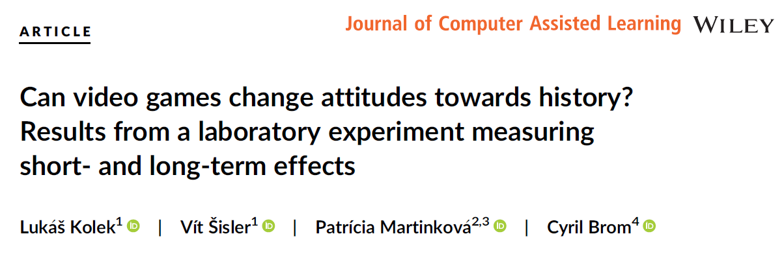
Case Study

Slide 5
Structure
The aim of the study?
Why it is interesting?
Theoretical Framework
What do we know so far?
Research design + intervention
Research sample
Hypotheses
Findings
Implications + Future + Limitations

Slide 6

Aim?
Can video games change
players‘ attitudes?
Notes:
If we talk about attitudes, think about the as just any evaluation of “summary evaluation of an object of thought. An attitude object can be anything a person discriminates or holds in mind”. The crucial characteristic of attitudes that if I evaluate an object object I do that with some degree of “favor or disfavor”
Value in evaluatil

Slide 7
Why interesting?
Historical video games became the most common form of popular history, possessing the potential to influence the formation of historical awareness in the society.
(Chapman 2013; 2016; Kapell and Elliott 2013)

Slide 8
Why attitudes?
Categorizing the environment into friendly or hostile
Information seeking and interpretation
Credibility of our source of information
Time devoted to source of information
Heuristic function

Slide 9
Why games?
Video games function as a source of information
Dynamic systems of information representations
We focus on narrative-driven games
Notes:
Hry mají funkci jako zdroj informací – especially narrative games (dramatic aspects provide meaning to processes)
We know very little about narrative games effects, but we can help using the evidence from studies of narratives im other media
narrative video games are interactive - players can shape game narratives and game worlds, perceive the outcomes of this interaction, and also react to these outcomes It provides them with agency and an
active role in influencing the game environment.
Empirical evidence suggests that the more a person has invested in the story, the more difficult it becomes to consider
counterarguments to tho Narratives based on real experiences or narratives that are credible enough to
actually happen can effectively influence attitudesse presented in the narrative

Slide 10
Explicit vs implicit attitudes
Explicit attitudes
Deliberate logical conclusions
Self-report measurements
Implicit attitudes
Spontaneous affective response
Response times measurements
Notes:
Explicit – you know – logical conclusion – probably know the questionnaires to what extent….
It is based on logical conclusions derived from information related to the object in question
(e.g., exercising is healthy, thus good). The conclusions therefrom are formed based on their consistency with other relevant conclusions related to the object that are stored in our short- and
long-term memory. Unlike associative evaluations, propositional reasoning must be in line with what one consciously considers to be truth.
Implicit attitudes – associations about particular objects. They are more spontaneous and affective. Not necesarilly in line with explicit attitudes
Immediate affective reactions to the object based on the object's relatability or familiarity with other concepts in our memory.
Spider example
Opera House example

Slide 11
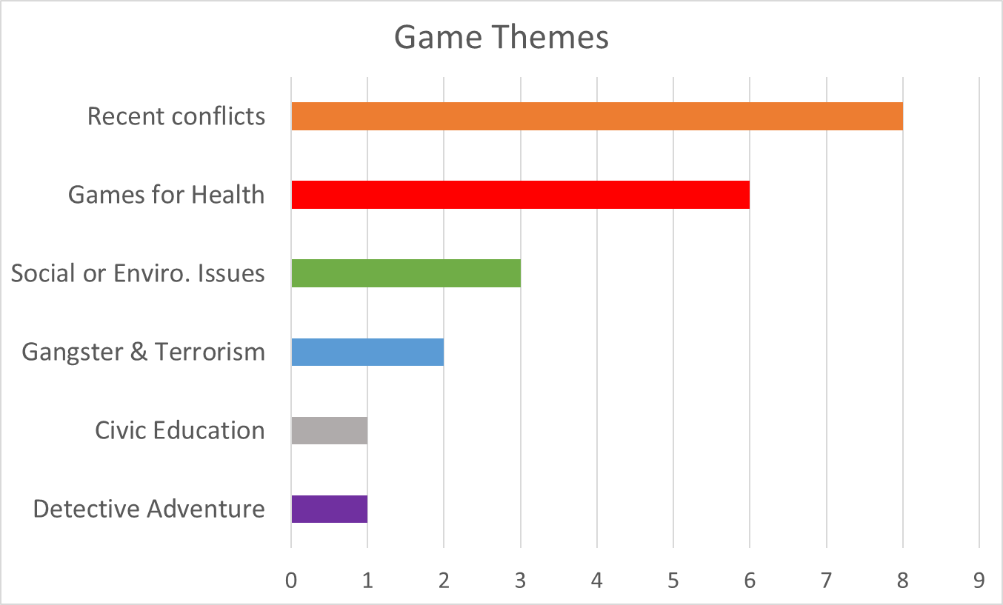
What do we know?
Notes:
Huge check of academic databases –
we found some studies with attitudes, but with a lot of limitatons

Slide 12
Research gap
No studies focused on attitude change and historical games
Most studies focused on short-term explicit attitude changes
No studies measuring long-term implicit attitude change
Most studies focused on students
Not enough data to analyse particular game mechanics
Notes:
Basically, we have confirmed that no one before us did this study and it is highly relevant to do it.
Why you do this?
If there were 500 studies focused on history and video games or attitudes and video games, would it be worth to invest more time into that? What would it bring?

Slide 13
Study overview
Data collection: Pretest-Posttest-Delayed Posttest
Research design: Between-subject (Exp & Ctrl group)
Theoretical model: APE model
Aim: Evaluate short and long-term explicit and implicit attitude changes
Topic: Expulsion of Sudeten Germans
Notes:
Basically, we have confirmed that no one before us did this study and it is highly relevant to do it.
Why you do this?
If there were 500 studies focused on history and video games or attitudes and video games, would it be worth to invest more time into that? What would it bring?

Slide 14
Experimental intervention
Authors: CUNI & Czech Academy of Sciences
Features: Based on Historical Research, Perspective-taking, Personal stories
Topics: 1945-1948 in Czechoslovakia; Expulsion of Sudeten Germans
Notes:
Basically, we have confirmed that no one before us did this study and it is highly relevant to do it.
Why you do this?
If there were 500 studies focused on history and video games or attitudes and video games, would it be worth to invest more time into that? What would it bring?

Slide 15


Slide 16


Slide 17
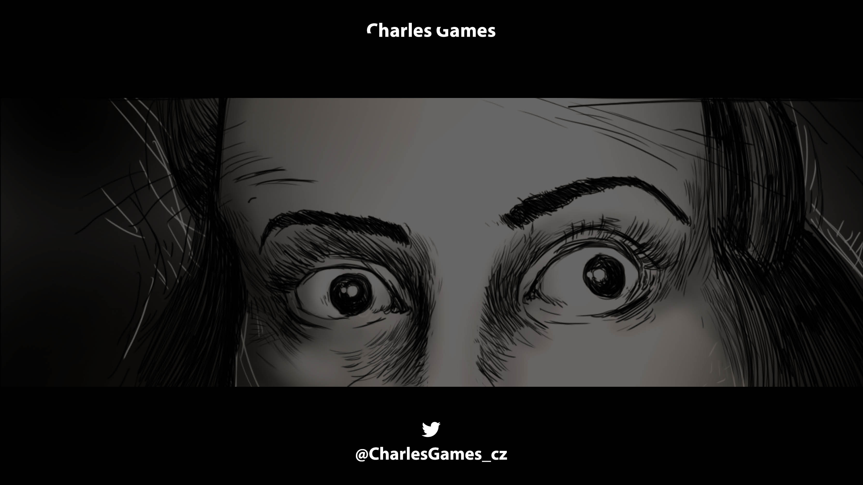
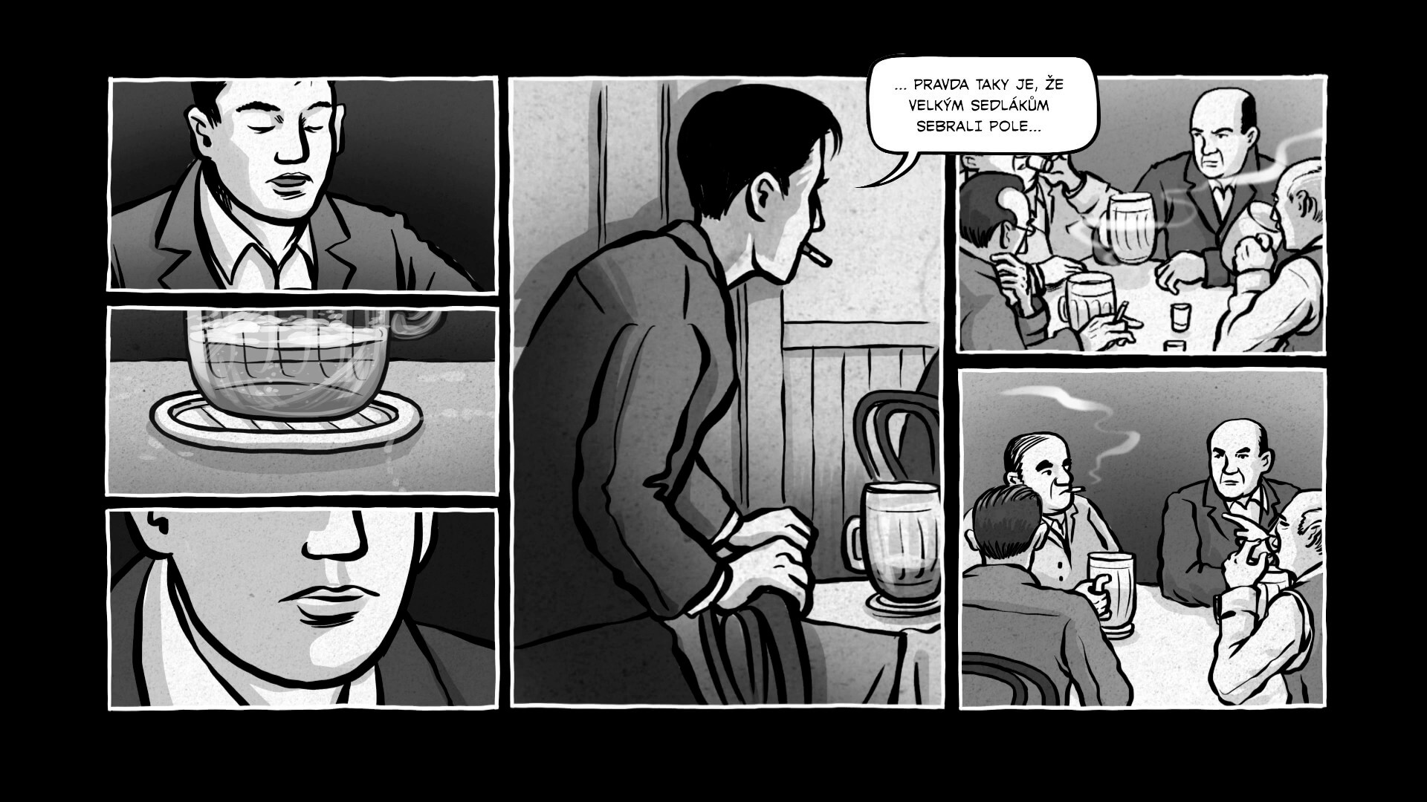

Slide 18
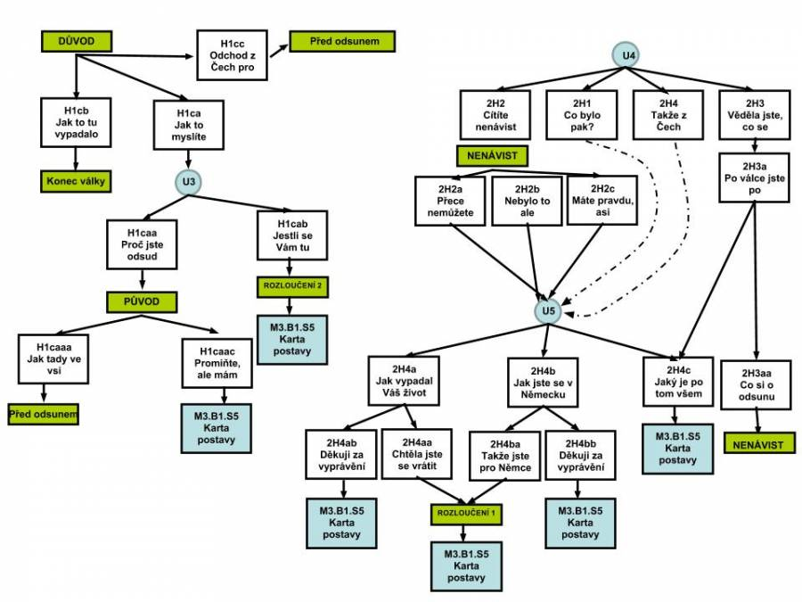

Slide 19
Control intervention
Authors: Rudowski Brothers
Features: Narrative Point-and-click fantasy adventure, collecting memories
Topics: Not related to expulsion of Sudeten Germans
Notes:
Basically, we have confirmed that no one before us did this study and it is highly relevant to do it.
Why you do this?
If there were 500 studies focused on history and video games or attitudes and video games, would it be worth to invest more time into that? What would it bring?

Slide 20
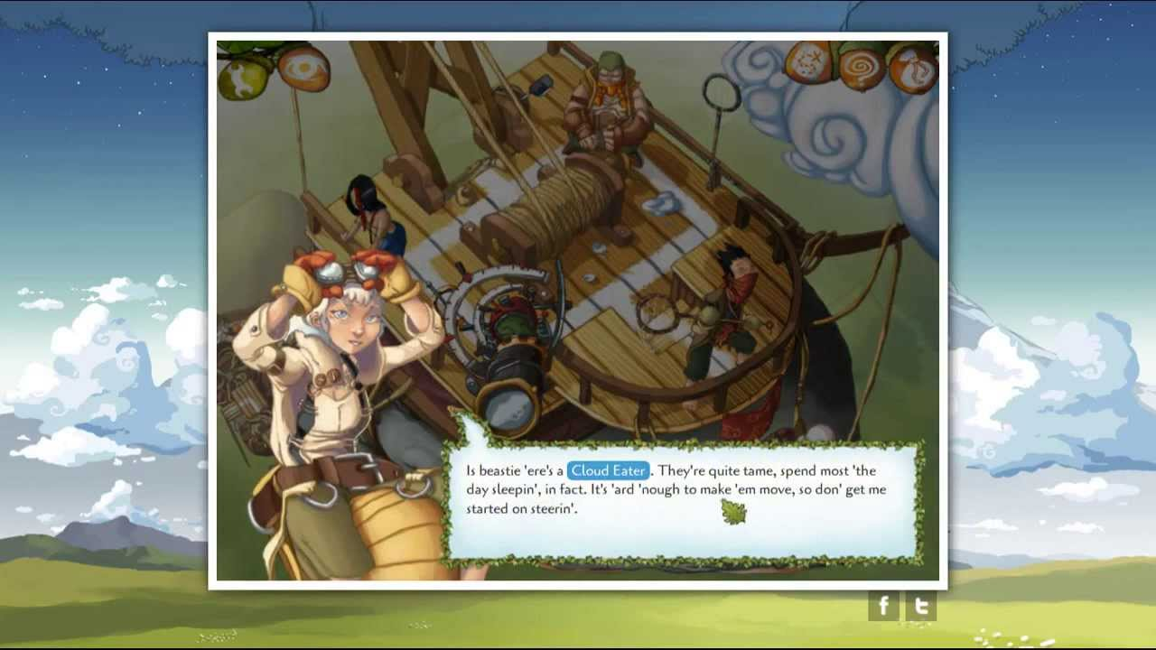

Slide 21
Research Sample?
Czech speakers aged between 15-30
M = 20,9, SD = 3.9, Women: 42.1 %
Posttest-Pretest Experimental Group n = 81
Control Group n = 64
Delayed Posttest-Pretest Experimental Group n = 73
Control Group: n = 46
Notes:
Basically, we have confirmed that no one before us did this study and it is highly relevant to do it.
Why you do this?
If there were 500 studies focused on history and video games or attitudes and video games, would it be worth to invest more time into that? What would it bring?

Slide 22
Hypotheses
H1: Short-term explicit attitude change (negative shift)
H2: Long-term explicit attitude change (negative shift)
H3: Short-term implicit attitude change (negative shift)
H4: No long-term implicit attitude change (no shift)
Explorative: analyse item level differences (DIF-C)
Notes:
Basically, we have confirmed that no one before us did this study and it is highly relevant to do it.
Why you do this?
If there were 500 studies focused on history and video games or attitudes and video games, would it be worth to invest more time into that? What would it bring?

Slide 23
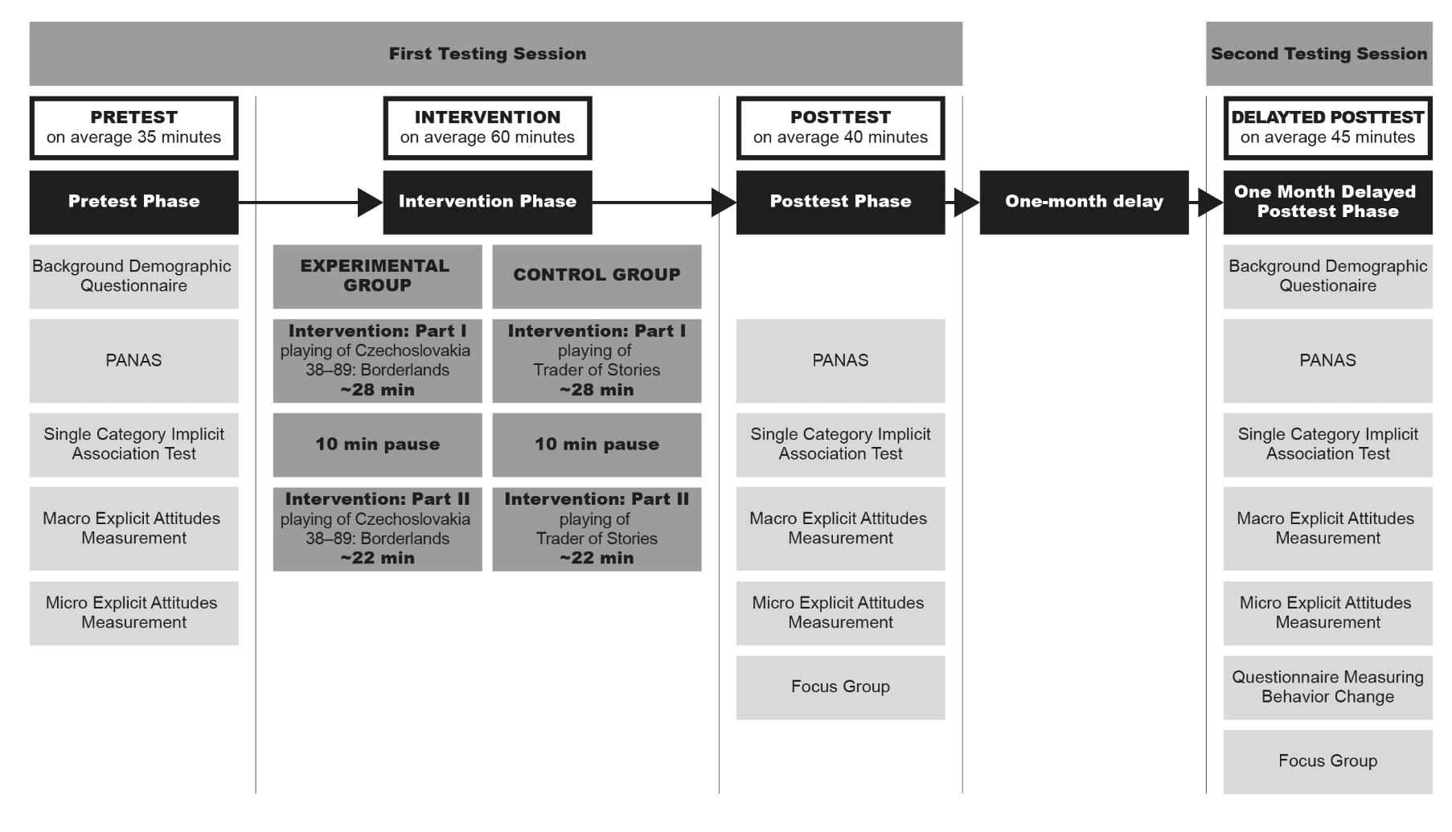

Slide 24
Negative adjectives
Positive Adjectives
Or Expulsion of Sudeten Germans
Unfair

Slide 25
Negative adjectives
Or Expulsion of Sudeten Germans
Positive Adjectives
Unfair

Slide 26
Main findings (vs control)
H1 Negative short-term explicit attitude change confirmed
(Macro: d= -0.34 Micro: d= -0.53)
H2 Negative long-term explicit attitude change confirmed
(Macro: d= -0.16 Micro: d= -0.44)
H3 Negative short-term implicit attitude change not supported
H4 No change of implicit attitudes in a long-term confirmed
Explo. items related to fairness and justness were affected more than the others.
Notes:
Basically, we have confirmed that no one before us did this study and it is highly relevant to do it.
Why you do this?
If there were 500 studies focused on history and video games or attitudes and video games, would it be worth to invest more time into that? What would it bring?

Slide 27
Implications
Alleged effect of video games on historical awareness confirmed in a short- and a long-term for the first time
Attitudes towards sensitive topics should be considered as a multidimensional construct
50 minutes long intervention did not affect implicit attitudes
Perspective-taking as a game mechanic can effectively change players‘ attitudes
Notes:
Basically, we have confirmed that no one before us did this study and it is highly relevant to do it.
Why you do this?
If there were 500 studies focused on history and video games or attitudes and video games, would it be worth to invest more time into that? What would it bring?

Slide 28
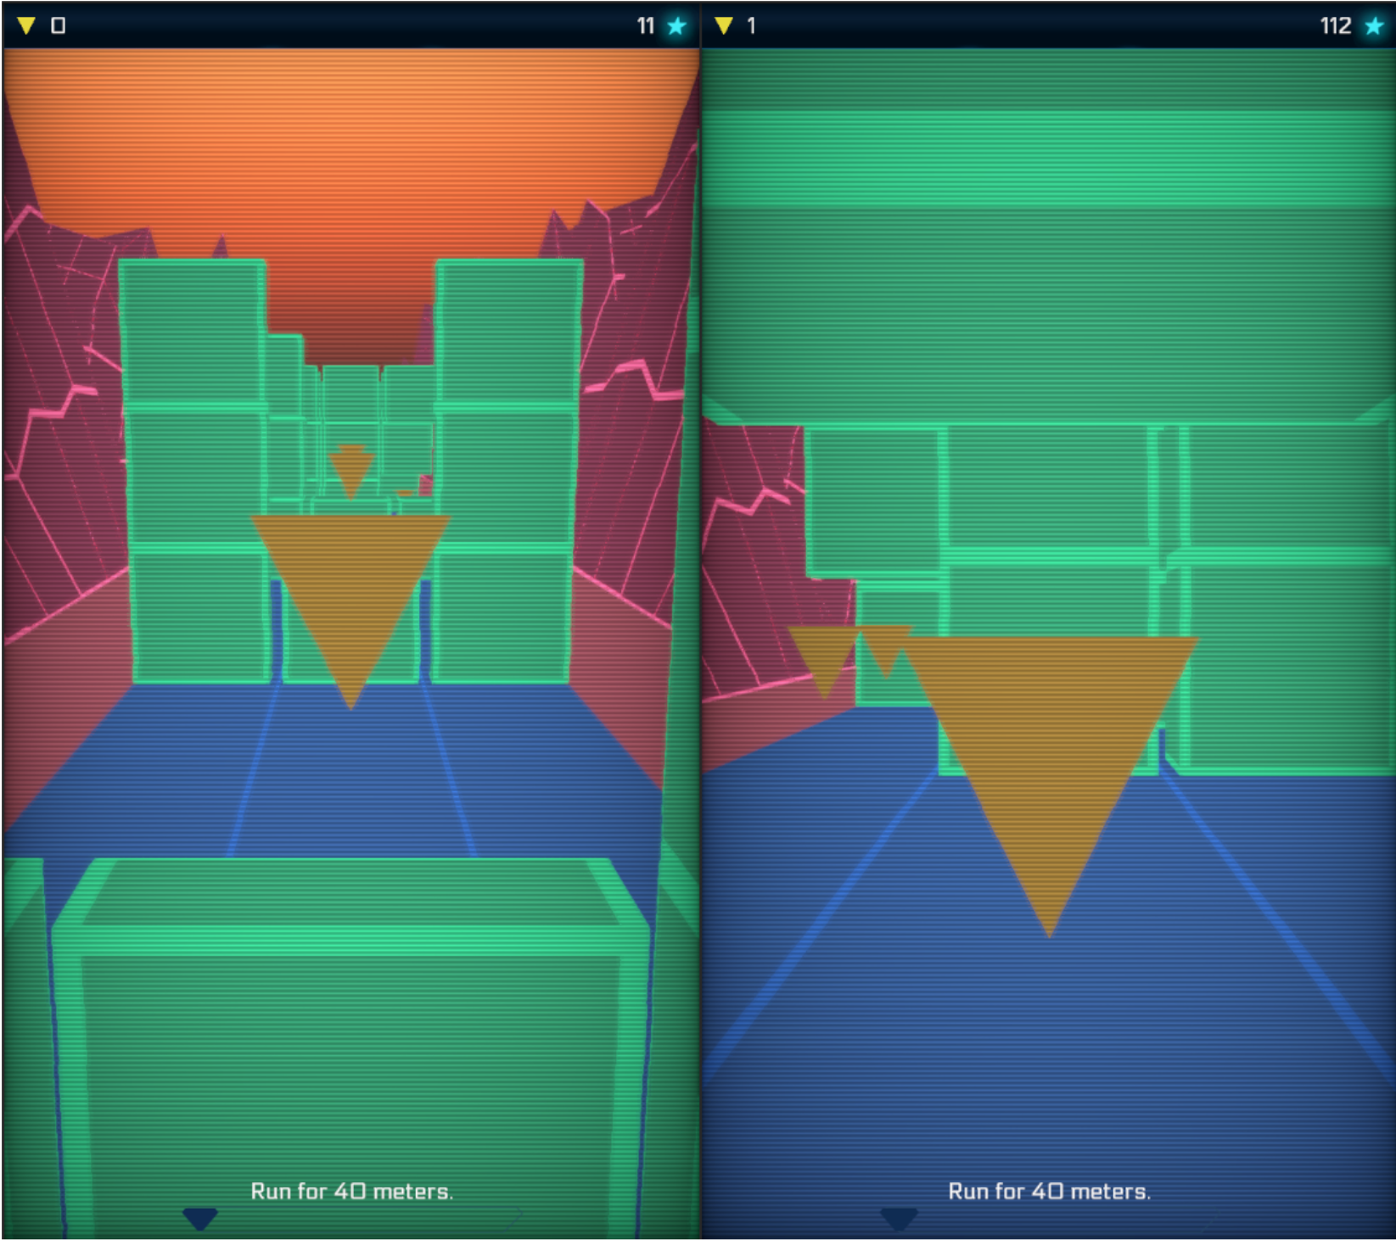
Endless Runner example
Jan Kočur :
Endless runner game with dynamic difficulty adjustment

Slide 29
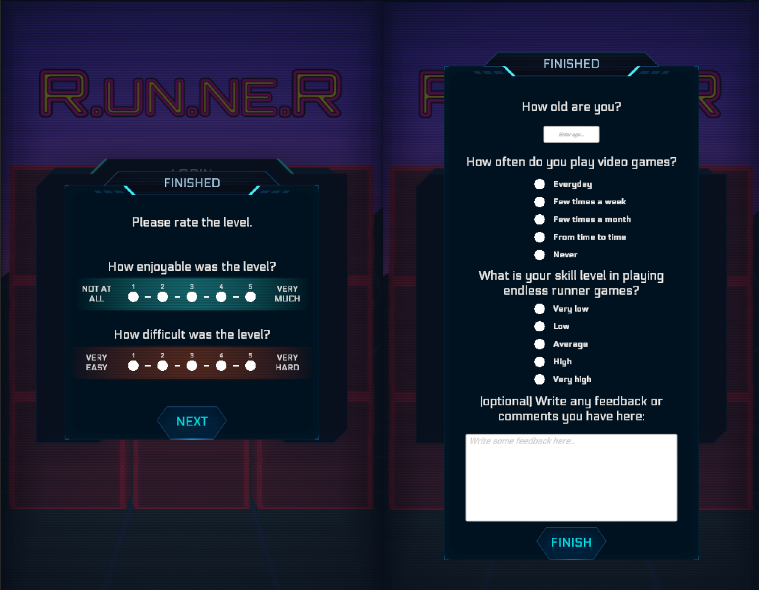

Slide 30
Hypothesis
Dynamically adjusted levels are more enjoyable than levels with progressive difficulty.
Players will die more in the progressive levels compared to levels with dynamic difficulty.
Flow occurs more often in levels with DDA compared to levels with increasing difficulty.
The difficulty predicted by the player model and the player’s perceived difficulty should get closer as the game progresses.

Slide 31
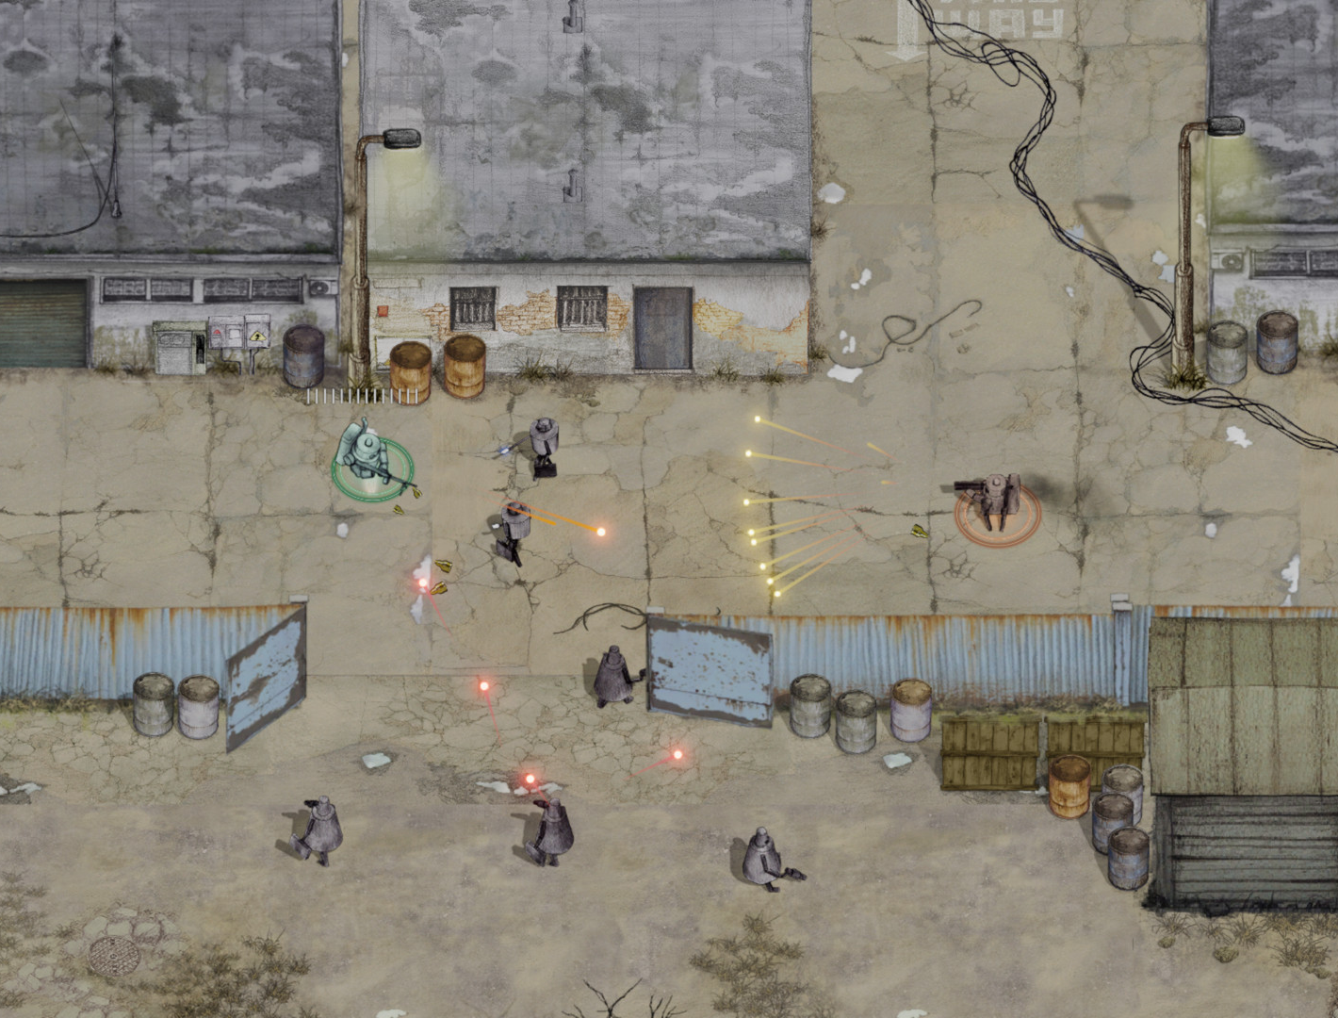
Research of Tutorials
Jan Holan
Design of
onboarding for a cooperative game

Slide 32
Hypothesis
Players of both games will be comparably successful in the game
Players with the version B (just in time) will consider it to be more fun compared to players with the version A

Slide 33
Summary
The aim of the study?
Why it is interesting?
Theoretical Framework
What do we know so far?
Research design + intervention
Research sample
Hypotheses
Findings
Implications + Future + Limitations

Slide 34
Faculty of Mathematics and Physics
Charles University
In case of questions:
kolek@ksvi.mff.cuni.cz
Stay in touch on Discord
Notes:
And for the obligatory Joke of the Day!
(click)
What’s the object-oriented way to become wealthy?
Inheritance of course!

